Slide 1
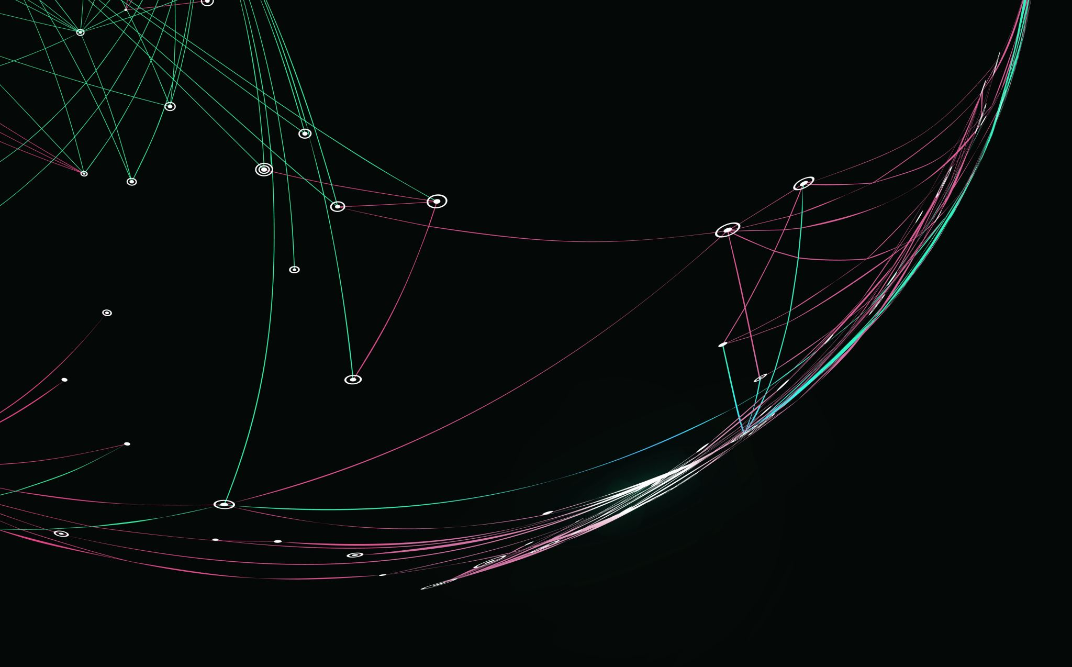
Solution for assignment

Slide 2
contents:
Describe 3 potential applications of FinTech and Saudi Arabia with at least one suggested application focused on how FinTech may be applied in the city of Neom. Provide links to research that you located that back up your suggestions.
Describe how you think Saudi FinTech companies can support financial inclusion in the emerging world. Provide links to research that you located to back up your suggestions where possible.
Identify an emerging technologies (e.g., LEO satellites, quantum computers, AI, etc.) and describe how you think it might transform FinTech solutions in the future. Provide links to research that you located that back up your suggestions.

Slide 3
Q1/Describe 3 potential applications of FinTech and Saudi Arabia with at least one suggested application focused on how FinTech may be applied in the city of Neom. Provide links to research that you located that back up your suggestions.
Tellus One of the niches and specific implementations of the fintech industry is Tellus. This fintech app is designed and developed to foster a seamless transactional environment for landlords and tenants. It allows app users to collect rent, pay rent, maintain all tenant information in one place for easy access and retrieval, perform screening of tenants, initiate services and repairs, in-app messaging, file sharing, and more. Truly a useful app.
Chime is another top mobile fintech app of 2021, which is also known as one of the fastest-growing mobile-only banks. It allows consumers to better manage their expenses and savings in one place. It levies zero transaction charges and offers free ATMs across the country. One of the best features of the app is that it automatically helps you save by deducting 10% of the amount credited to your account and transferring it to your savings account.
A robotic restaurant is a restaurant that uses a robot to perform tasks such as delivering food and drinks to tables, cooking food, or both. Such robots are used in place of human labor (waiters).

Slide 4
Q2/Describe how you think Saudi FinTech companies can support financial inclusion in the emerging world. Provide links to research that you located to back up your suggestions where possible.
PayTabs Company Offers electronic solutions to process financial payments. And PayTabs has designed its product suite keeping small and medium sized businesses in mind, so that they can start receiving online payments using PayTabs regardless of the existence of your own website. Online Payment Gateway Solutions, Secure Payment Integration.

Slide 5
Q3/Identify an emerging technologies (e.g., LEO satellites, quantum computers, AI, etc.) and describe how you think it might transform FinTech solutions in the future. Provide links to research that you located that back up your suggestions.
The use of artificial intelligence for internal and external audit of organizations to ensure From the extent of compliance with the rules and procedures of the company and the government, and this will contribute to raising accuracy and speed, and reducing costs and effort.

Slide 6

Reference:
https://www.techtic.com/blog/best-fintech-apps/amp/
paytabs.com

Slide 7

Thanks for all
Student (Group 7 Fintech Future):
1-Malak Alsuroor
2-Amjad Alqarni
3-Somaya Abodabeel
4-Sarah Almaghthawi
5-Nada Ghamdi

